Slide 1
THE BIKE HAVEN
TABLEAU PROJECT
PREPARED BY
KUNUR ARCHANA
PGC-DATA SCIENCE
15 MARCH BATCH

Slide 2
PROBLEM STATEMENT
Create a visually interactive and informatice dashboard of sales data of a bike shop named ‘The Bike Haven’ in Tableau.

Slide 3
TASKS
TOP 10 PRODUCTS BY SALES AMOUNT
TOP 10 CUSTOMERS I.E., MOST VALUABLE CUSTOMERS
SALES FIGURE VS BUDGET
SALES FIGURES BY REGION/CITY
PRODUCT CATEGORY VS SALES AMOUNT

Slide 4
END RESULTS
THE DASHBOARD THAT PROVIDES THE QUICK AND LATEST SALES INSIGHTS IN ORDER TO GIVE THE DATA FOR DECISION MAKING

Slide 5
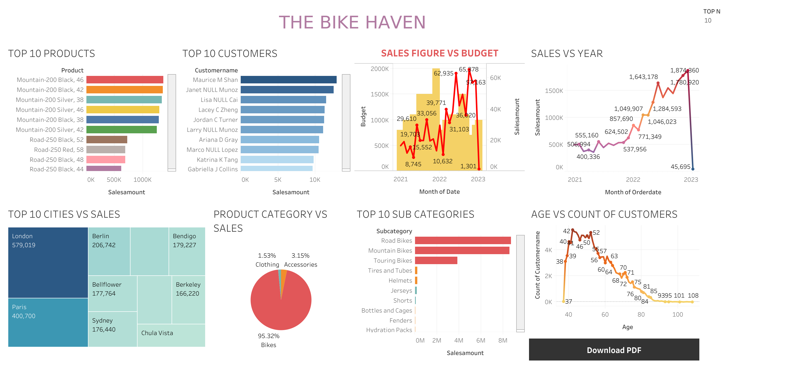

Slide 6
LINKS
VIDEO LINK--https://drive.google.com/file/d/1d6kxeLTLSUKTwD3ZLozstw2LUWrsaQRd/view?usp=sharing
TABLEAU PDF--https://drive.google.com/file/d/1ycwHn8Bp358VLvdAaScgB4kmL4kqauxY/view?usp=sharing

Slide 7


